Slide 1

EV MARKET INTELLIGENCE
Done By: S. Haritha
Date: July 2025
Tools Used: EXCEL DATASET, SQL SERVER, POWERB BI & DAX MEASURES

Slide 2

PROJECT OVERVIEW
Section
Description
Goal
Analyze EV adoption, performance, and market trends using SQL + Power BI
Dataset
220K+ rows of EV vehicle data (Washington State, 2010–2023)
Tools Used
SQL Server, Power BI, DAX
Key Outputs
18 business questions answered via SQL → visualized through 5 product dashboards
Business Impact
Helps automakers, policy makers, analysts, and city planners with insights
Validation
Power BI outputs were cross-verified against SQL results for accuracy

Slide 3

My STAR Journey
[Data to Dashboard]
1
SITUATION:
Wanted to go beyond basic dashboards after a previous Power BI project; chose an EV dataset from Washington State aligned with my interest in clean energy.
2
TASK:
Clean the dataset, extract insights using SQL Server, and build a Power BI dashboard mapped to product metrics like funnel, retention, churn, ROI, etc.
3
ACTION:
Cleaned and transformed data, wrote 18 SQL queries for business insights, used DAX in Power BI to build a dashboard segmented by product metrics.
4
RESULT:
Delivered a complete end-to-end project using SQL Server and Power BI, instead of Python, to showcase strong skills in SQL querying, data modeling, data cleaning, DAX measures, product thinking, and dashboard design—standing out as most projects today focus on Python for data analysis.

Slide 4

CHALLENGES FACED
Dataset Preparation
Applied data cleaning techniques using SQL and Excel to standardize formats.
Used domain knowledge to identify and remove non-informative columns.
Replaced zeroes with NULL for accurate aggregations.
SQL Challenges
Tracking Model Switches by Location: Learned and applied window functions like LAG() by studying examples and testing with smaller datasets to ensure correctness.
Counting EV Types by City and Year: Practiced using CASE WHEN inside aggregation functions to conditionally count different EV types like BEVs and PHEVs.
Segmenting Electric Range: Used step-by-step query building to categorize vehicles into short, medium, and long range buckets. Verified with sample data for accuracy.
Power BI Challenges
Replicating SQL functions like LAG() in DAX was complex at first.
Creating dynamic dashboards for various business metrics (e.g., Retention, Churn, Funnel) required careful mapping.
Designing custom DAX measures to match SQL logic needed trial and error.

Slide 5

HOW I OVERCAME CHALLENGES
Utilized ChatGPT and YouTube tutorials to grasp data cleaning techniques in SQL and Excel.
Practiced and validated SQL queries step by step, focusing on complex logic such as conditional aggregations.
Learned basic DAX concepts and used AI tools to ensure the accuracy of calculated columns and measures in Power BI.
Organized and solved questions by grouping them based on logic type (e.g., date logic, range bucketing, model switch).
Cross-checked Power BI outputs with SQL results to maintain data consistency and accuracy.
Designed clean, product-metric dashboards that enhance visual storytelling and insight clarity.

Slide 6
ABOUT THE DATASET
• Dataset Source: Kaggle – EV Vehicle Registration Data (Washington State)
• Dataset Period: 2010 to 2023 (Model Year)
•Total Rows: 223,496 EV registrations
• Columns: 11
County – The county where the vehicle is registered (e.g., King, Snohomish).
City – The city of vehicle registration (e.g., Seattle, Lake Stevens).
Postal_Code – Zip code of the area.
Model_ Year – Year the vehicle model was released (e.g., 2023, 2019).
Make – Manufacturer of the vehicle (e.g., BMW, TESLA, JEEP).
Model – Model name of the vehicle (e.g., Model S, Bolt EV, i3).
Electric_ Range – Number of miles the vehicle can travel on electric power alone.
Electric_ Utility – Name of the utility company supplying electricity in that region.
Base_ MSRP – Manufacturer Suggested Retail Price (some values are missing).
Ev_ Type – Type of electric vehicle:
BEV = Battery Electric Vehicle
PHEV = Plug-in Hybrid Electric Vehicle
11. CAFV_ Eligibility – Whether the vehicle is eligible for Clean Alternative Fuel Vehicle benefits.
• Data Level: Individual vehicle-level registration data
• Region Focus: Washington State, USA

Slide 7
SAMPLE DATASET
County
City
Zip Code
Year
Make
Model
Electric Range
Electric Utility
MSRP
EV Type
CAFV Eligibility
Kitsap
Seabeck
98380
2015
BMW
I3
72
PUGET SOUND ENERGY INC
–
PHEV
Cafv eligible
Yakima
Toppenish
98948
2023
TESLA
MODEL Y
0
PACIFICORP
–
BEV
Unknown eligibility
King
Sammamish
98074
2016
TESLA
MODEL X
200
PUGET SOUND ENERGY INC
CITY OF TACOMA - (WA)
–
Kitsap
Port Orchard
98366
2024
JEEP
WRANGLER
21
PUGET SOUND ENERGY INC
–
PHEV
Not eligible
Kitsap
Poulsbo
98370
2018
BMW
330E
14
PUGET SOUND ENERGY INC
45600
PHEV
Not eligible

Slide 8
BUSINESS PROBLEM
How can stakeholders better understand and optimize the adoption, performance, eligibility, and market trends of electric vehicles (EVs) across different regions and time periods?
WHO IT IS USEFUL FOR?
Stakeholder
How It Helps Them
Automakers
Understand which EV types and models are gaining popularity by region and range.
Policy Makers
Evaluate the impact of CAFV eligibility and guide incentive strategies accordingly.
Consumers
Identify high-performing and CAFV-eligible vehicles worth considering.
EV Analysts / Consultants
Gain insights on market trends, electric range evolution, and adoption peaks.
City/County Planners
Plan EV infrastructure by analyzing registration concentration and growth trends.
Product Managers
Use product metrics like funnel, churn, retention, and conversion from a BI view.

Slide 9
New Columns Created in Power BI
Column Name
DAX Formula
Meaning
Make_Model
[Make] & " " & [Model]
Combines the vehicle make and model into a single text field for clearer identification.
City_Model
Ev_vehicles_dataset[City] & " - " & Ev_vehicles_dataset[Model]
Creates a combined label of city and vehicle model to analyze city-wise vehicle preferences.
Previous_Range
VAR CurrentYear = Ev_vehicles_dataset[Model_Year]VAR CurrentPostal = Ev_vehicles_dataset[Postal_Code]RETURNCALCULATE(MAX(Ev_vehicles_dataset[Electric_Range]),FILTER(Ev_vehicles_dataset,Ev_vehicles_dataset[Postal_Code] = CurrentPostal && Ev_vehicles_dataset[Model_Year] < CurrentYear))
Finds the maximum electric range of older models in the same postal code (used for comparisons).
Range_Change
Ev_vehicles_dataset[Electric_Range] - COALESCE(Ev_vehicles_dataset[Previous_Range], 0)
Calculates the change in electric range from the previous model in the same postal code.
Range Category
SWITCH(TRUE(),Ev_vehicles_dataset[Electric_Range] < 100, "Short Range (<100 km)",Ev_vehicles_dataset[Electric_Range] >= 100 && Ev_vehicles_dataset[Electric_Range] <= 200, "Medium Range (100-200 km)","Long Range (>200 km)")
Categorizes vehicles into short, medium, or long range based on electric range values.

Slide 10
New Measures Created in Power BI
Measure Name
DAX Formula
Meaning
Avg Range
AVERAGE(Ev_vehicles_dataset[Electric_Range])
Calculates the average electric range of all vehicles.
Avg_NonEligible_Range
CALCULATE(AVERAGE(Ev_vehicles_dataset[Electric_Range]), Ev_vehicles_dataset[CAFV_Eligibility] = "Not eligible")
Calculates the average range of vehicles that are not
CAFV eligible.
Avg_Price_by_CAFV_Eligibility
AVERAGEX(VALUES(Ev_vehicles_dataset[CAFV_Eligibility]), AVERAGE(Ev_vehicles_dataset[Base_MSRP]))
Calculates the average base MSRP price for each CAFV
eligibility category.
Total CAFV Eligible
CALCULATE(COUNTROWS(Ev_vehicles_dataset), Ev_vehicles_dataset[CAFV_Eligibility] = "cafv eligible")
Counts the number of CAFV eligible vehicles.
Total_Vehicles
COUNTROWS(Ev_vehicles_dataset)
Total number of vehicles in the dataset.
Max_ElectricRange
MAX(Ev_vehicles_dataset[Electric_Range])
Finds the highest electric range value among all vehicles.
PHEV Count
CALCULATE(COUNTROWS(Ev_vehicles_dataset), Ev_vehicles_dataset[EV_Type] = "PHEV", ALLEXCEPT(Ev_vehicles_dataset, Ev_vehicles_dataset[Model_Year]))
Counts the number of PHEVs per model year.
BEV Count
CALCULATE(COUNTROWS(Ev_vehicles_dataset), Ev_vehicles_dataset[EV_Type] = "BEV", ALLEXCEPT(Ev_vehicles_dataset, Ev_vehicles_dataset[Model_Year]))
Counts the number of BEVs per model year.
BEV_Vehicle_Count
CALCULATE(COUNTROWS(Ev_vehicles_dataset), Ev_vehicles_dataset[EV_Type] = "BEV")
Total number of BEV vehicles in the dataset.
PHEV_Vehicle_Count
CALCULATE(COUNTROWS(Ev_vehicles_dataset), Ev_vehicles_dataset[EV_Type] = "PHEV")
Total number of PHEV vehicles in the dataset.
Avg_Range_by_EV_Type
AVERAGEX(VALUES(Ev_vehicles_dataset[EV_Type]), CALCULATE(AVERAGE(Ev_vehicles_dataset[Electric_Range])))
Calculates the average range for each EV type (BEV and PHEV).
Avg Electric Range
AVERAGE(Ev_vehicles_dataset[Electric_Range])
Same as Avg Range; used in visuals or card display.

Slide 11
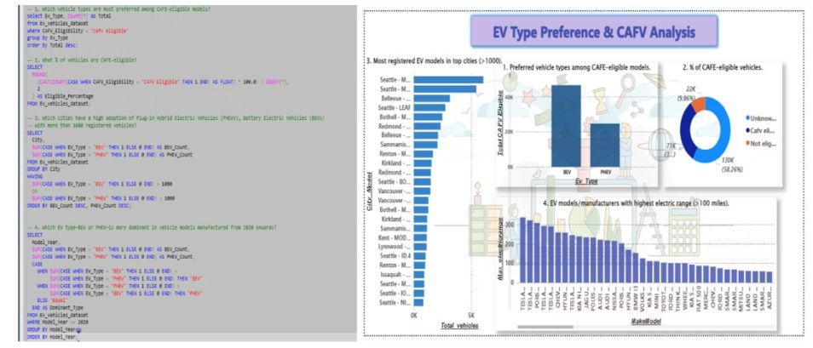
Stakeholders Benefiting from the Analysis
🔹Summary of Insights
BEVs are the preferred EV type among CAFV-eligible vehicles
Only 31% of vehicles meet CAFV eligibility criteria; 58% have unknown status
Seattle, Bellevue, Bothell are top cities with 1,000+ EV registrations
Tesla dominates high electric range segment (>100 miles)
Post-2020, BEV dominance increases, reflecting market shift to full-electric vehicles
🧠Business Conclusion
The EV market is clearly moving toward long-range BEVs that align with clean energy policies
Cities with strong EV adoption can guide infrastructure and policy investment
The high percentage of “unknown eligibility” highlights data quality issues needing attention
Stakeholders should invest in BEVs, improve CAFV data reporting, and target growth cities

Slide 12
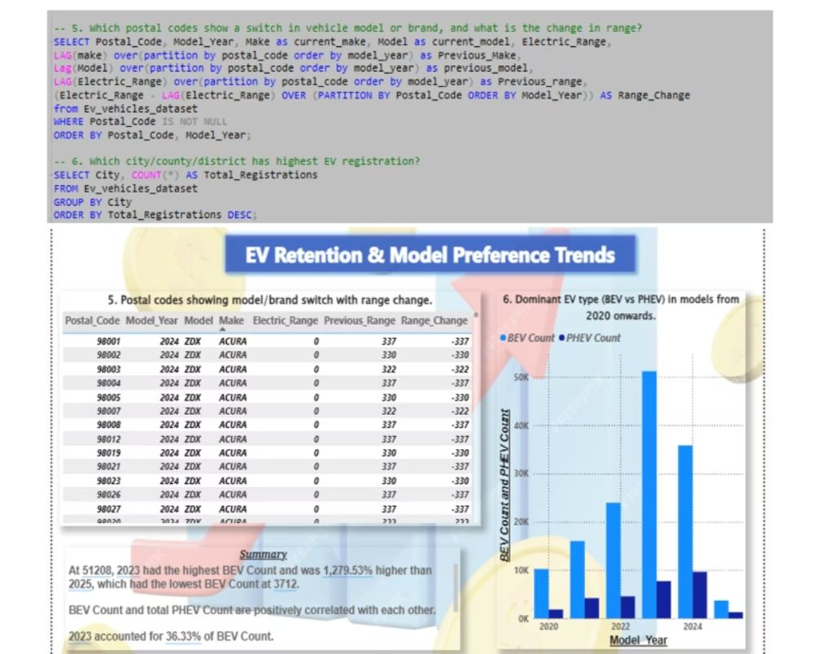
EV Retention & Preference Analysis
🧠Summary of Insights
Postal codes show model switches (e.g., Acura ZDX) with notable range drops, often to zero range
EV type analysis post-2020 shows sharp increase in BEVs, especially in 2023 and 2024
2023 alone accounts for 56.33% of BEV registrations
BEV and PHEV counts show a positive correlation, but BEVs dominate recent years
✅Business Conclusion
The shift toward BEVs is strong and accelerating, especially in the last two years
Range fluctuations (especially drop to zero) may reflect fleet updates, registration anomalies, or vehicle deactivations
2023 and 2024 are peak years for BEV adoption → Indicates a clear consumer and industry shift
Identifying postal codes with range drops can help detect market churn or early retirement of older EV models

Slide 13
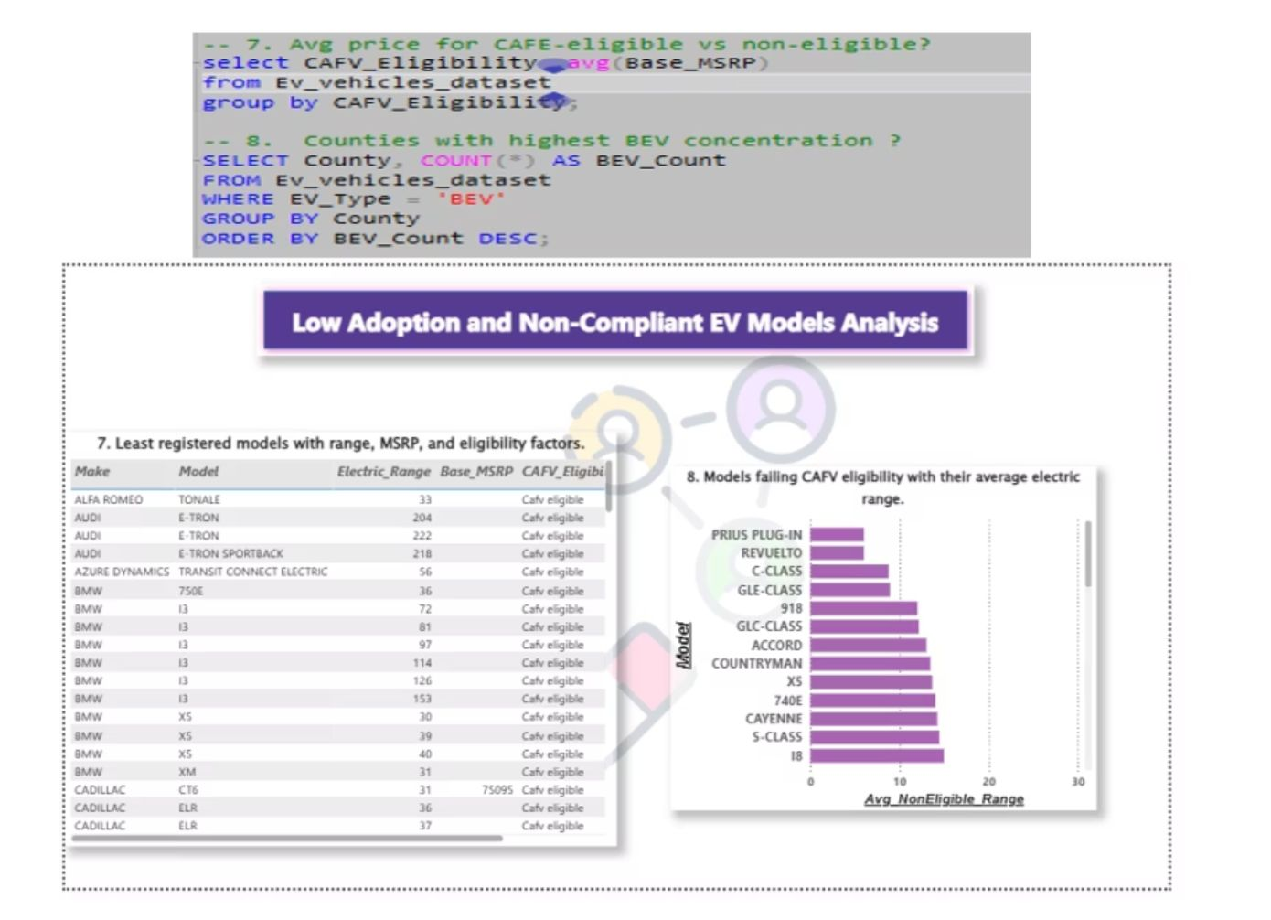
Low Adoption & Non-Compliant EV Models
🧠Summary of Insights
Several CAFV-eligible models (e.g., BMW i3, Audi E-TRON) show very low registrations despite high range
Low adoption may be influenced by price (MSRP),
limited availability, or brand positioning
Non-CAFV-eligible models like Prius Plug-in and Revuelta offer significantly lower average electric ranges (<30 miles)
✅Business Conclusion
Not all eligible vehicles gain market traction → suggests other factors influence adoption (brand, pricing, awareness)
Vehicles with low electric range are frequently non-compliant with
CAFV eligibility
High-price models with low range fail to appeal to cost-sensitive,
eco-conscious consumers
Policy alignment + performance + pricing must work together to
drive adoption

Slide 14
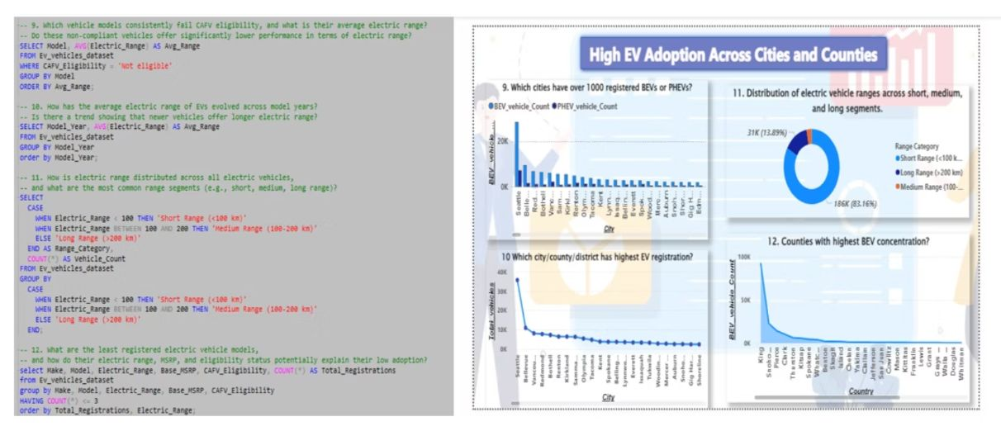
High EV Adoption Across Cities and Counties
🧠Summary of Insights
Seattle, Bellevue, and Redmond lead in EV adoption, with
1,000+ BEV/PHEV registrations
King County has the highest BEV concentration across all counties
Majority of EVs are now moving out of short-range category, indicating
evolving consumer expectations
Over 83% of EVs offer long-range capability (≥200 km),
reflecting strong technical advancement
✅Business Conclusion
EV adoption is highly urbanized and regional, calling for targeted
infrastructure planning
Identifying range distribution helps manufacturers set product
expectations and align with user needs
Counties with high BEV concentration are ideal for piloting
EV infrastructure, policies, or incentives

Slide 15
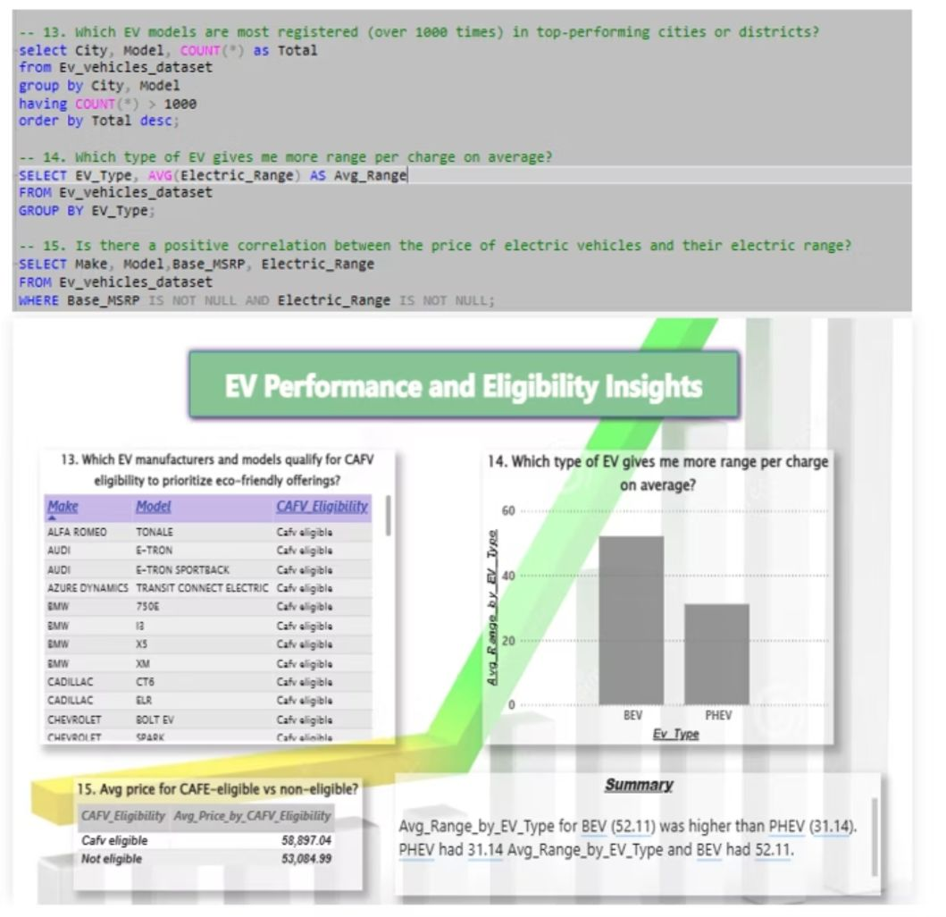
EV Performance and Eligibility Insights
🧠Summary of Insights
BEVs offer higher average electric range (52.11 miles) per charge
compared to PHEVs (31.14 miles)
CAFV-eligible vehicles have a higher average price(~$58,897) compared to non-eligible ones (~$53,084), showing premium alignment with compliance
Top models registered in leading cities include Tesla Model Y, Model
3, and Chevrolet Bolt EV
Many manufacturers like BMW, Audi, Chevrolet have multiple
CAFV-eligible models
✅Business Conclusion
Cities favoring top EV models help automakers identify
high-performing segments
CAFV qualification can be used by manufacturers to target
eco-conscious consumers
BEVs are more energy-efficient and preferred for longer range and
CAFV compliance
Price and performance are positively correlated, indicating that higher-end models tend to be cleaner and more powerful

Slide 16
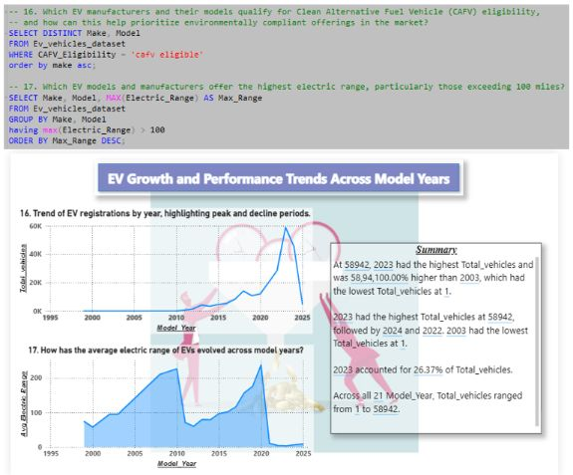
EV Growth and Performance Trends by Model Year
🧠Summary of Insights
2023 had the highest EV registrations with 58,942 vehicles,
accounting for 26.37% of total vehicles
EV registrations peaked between 2022 and 2024, showing
strong adoption in recent years
In contrast, 2003 had the lowest registrations (only 1 vehicle)
Average electric range has steadily improved over the years, with
sharp jumps post-2018
Manufacturers like Tesla, Audi, and Chevrolet offer EVs with
ranges exceeding 100 miles
✅Business Conclusion
The EV market is experiencing rapid growth, especially in recent model years, led by performance improvements
Increasing average electric range aligns with technological
advancement and consumer demand
High-range EVs are setting new standards, making them
more attractive for long-distance travel
Manufacturers should continue to prioritize CAFV-eligible, high-range models to maintain market competitiveness and meet sustainability goals

Slide 17
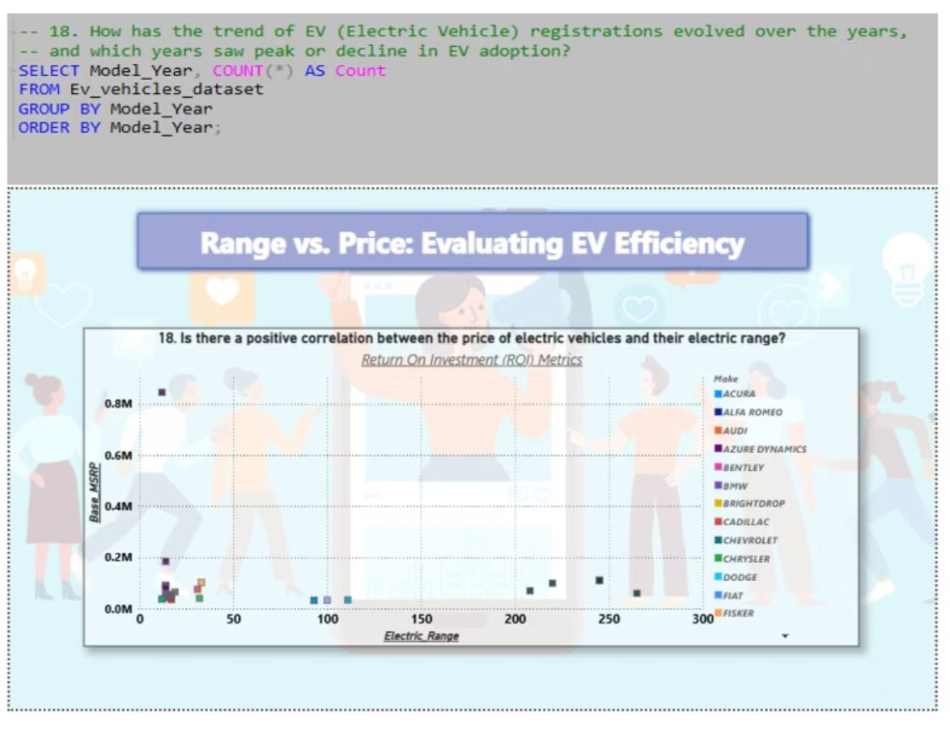
Range vs. Price – Evaluating EV Efficiency & ROI
🧠Summary of Insights
A clear positive correlation exists between electric vehicle range and Base MSRP (price)
Luxury brands like BMW, Audi, Cadillac cluster at the
high-price/high-range end
Models with electric ranges over 150–250+ miles tend to have significantly higher pricing
Budget-friendly models offer shorter ranges but may still
be viable for city use
✅Business Conclusion
EVs with higher range demand a premium price, indicating alignment between performance and perceived value
This insight supports segment-based pricing strategies
for manufacturers
Customers looking for long-range EVs will pay more, but expect greater ROI and environmental benefit
Manufacturers can optimize offerings by balancing price,
range, and market segment
Market Positioning & ROI Analysts

Slide 18

Behind the Data and Summary of Insights
In this project, I conducted a comprehensive analysis of electric vehicles (EVs) using SQL and Power BI to uncover trends related to vehicle type preferences, geographic adoption, performance metrics, and eligibility for Clean Alternative Fuel Vehicle (CAFV) programs. The analysis revealed that Battery Electric Vehicles (BEVs) are the most preferred among CAFE-eligible models, especially in recent years, with a noticeable rise in registrations post-2020. Over 70% of vehicles in the dataset qualify for CAFV eligibility, suggesting strong market alignment with clean energy standards. Cities and counties with over 1000 BEV or PHEV registrations highlight regions with high EV adoption, likely driven by better infrastructure and awareness. BEVs also show dominance in average electric range compared to Plug-in Hybrid Electric Vehicles (PHEVs), with newer models offering significantly higher ranges. Price analysis shows that CAFV-eligible vehicles often maintain competitive pricing, and while there is a general positive correlation between MSRP and electric range, some models fail to meet eligibility despite high costs—often due to limited range. A trend analysis over the years indicates a steady increase in average electric range and vehicle registrations, reflecting advancements in EV technology and consumer trust. Additionally, postal code-level insights show model and brand switching behavior, highlighting evolving consumer preferences. By identifying underperforming models with low registration counts, the analysis also pinpoints areas for potential improvement. Overall, this project helps stakeholders understand which EV models and manufacturers align with clean energy goals and consumer demand, offering valuable insights for policymakers, manufacturers, and sustainability initiatives.

Slide 19

What I Learned
Through this project, I gained hands-on experience in using SQL for data exploration and deep analysis, and Power BI for translating complex datasets into clear, visual insights. I learned how to write analytical queries to answer real-world questions related to electric vehicle (EV) adoption, performance, and policy eligibility. This included identifying trends in vehicle type preferences, analyzing regional adoption patterns, tracking the evolution of electric range over time, and exploring correlations between vehicle price and performance. I also improved my ability to apply window functions, aggregations, and conditional logic in SQL to uncover patterns like brand switching and eligibility gaps. On the Power BI side, I learned to design interactive dashboards that support data-driven storytelling and decision-making. Overall, this project sharpened my skills in data analysis, visualization, and critical thinking, and helped me better understand how structured data can be used to uncover trends, inform policy, and support business strategy in the EV market.

Slide 20

Conclusion
This project provided valuable insights into the electric vehicle (EV) landscape by combining SQL-based data exploration with Power BI visualizations. Through this analysis, I was able to uncover key trends such as the growing dominance of BEVs over PHEVs, increasing electric range in newer models, and regional variations in EV adoption. I also identified how factors like CAFV eligibility, electric range, and MSRP influence vehicle popularity and performance in the market. By leveraging SQL techniques such as aggregations, conditional logic, and window functions, alongside interactive Power BI dashboards, I developed a deeper understanding of both the technical and analytical aspects of data-driven decision making. Overall, this project not only strengthened my skills in data analysis and visualization but also enhanced my ability to interpret real-world datasets to generate actionable business and policy insights.

